Slide 1
CSC 256: Final Review
Zonghua Gu
Department of Computer Science,
Hofstra University

Slide 2
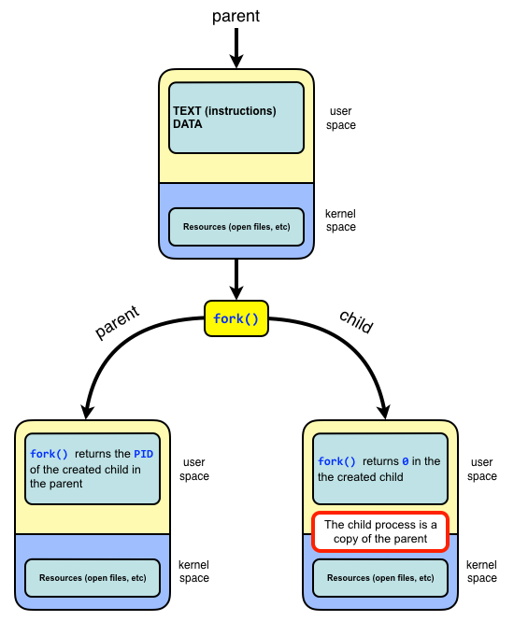
fork()
A function without any arguments
ret = fork()
Both parent process and child process continue to execute the instruction following the fork()
The return value indicates which process it is (parent or child)
ret > 0 (pid of child process): code running in the parent process,
ret == 0: code running in the newly-created child process
ret == -1: an error or failure occurred when creating new process
Fun analogy: imaging you are a process after fork, but you don’t know if you are the child or parent process, as if you are running inside of a Matrix. But you can identify which process you are running, by looking up to the sky and see the ret value from fork()
Child process is a duplicate of its parent process and has same
instructions, data, stack
Child and parents have different
PIDs, memory spaces
Notes:
fork() returns 0 in child process and process ID of child process in parent process.

Slide 3
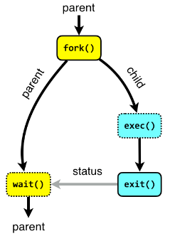
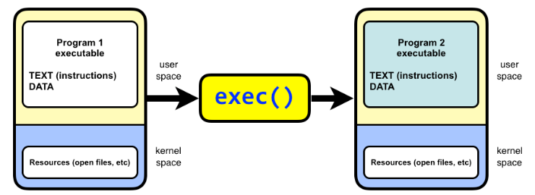
exec()
exec(cmd, argv) replaces the current process image with a new process image specified by the path to an executable file.
It does not return. It starts to execute the new program.
There is a family of exec(), e.g., execl(), execvp()
execl() takes a variable number of arguments that represent the program name and its arguments.
int execl(const char *path, const char *arg, ..., NULL);
execvp() takes an array of arguments instead of a variable-length argument list
int execvp(const char *file, char *const argv[]);
Notes:
You may not have the exec command instead you have several alternatives you can use in different situations
Returns if errors occur
Replace current data and code with new in specified file, i.e., it loads a new program into the current process
exec(cmd, argv)

Slide 4
wait()
Let the parent process wait for the completion of the child process
pid = wait()
wait() suspends the execution of the calling process until one of its child processes terminates.
When a child process terminates, wait() retrieves its termination status and allows the system to clean up the resources associated with that child. If the parent does not call wait() to collect the child's exit status, the child becomes a zombie process, which means its PCB persists in the process table, even though it is no longer running.
While zombie processes do not consume processor or memory resources, they occupy entries in the process table. The process table is of finite size, and if too many zombie processes accumulate, it can prevent new processes from being created.
If there are multiple child processes, wait() does not allow the parent to specify which child process to wait for. waitpid(pid) is an advanced version of wait. It allows the parent process to specify which child process (or group of processes) it wants to wait for.
Parent
fork()
wait()
Child
Parent
Notes:
It will reap any terminated child arbitrarily. process (preventing it from becoming a zombie process

Slide 5
L2 Summary
Processes
In OS, process is a running program and has an address space
We use process API to create and manage processes
fork() to duplicate a process, exec() to replace the command
Threads:
Multiple threads per process / address space
Kernel threads are much more efficient than processes, but they’re still not cheap
User-level threads are very efficient
Notes:
What is Thread Synchronization?
https://www.youtube.com/watch?v=8_CRd1R5g98
fast
great for common-case operations
creation, synchronization, destruction
can suffer in uncommon cases due to kernel obliviousness
I/O
preemption of a lock-holder

Slide 6
Race Condition
Incrementing counter has 3 instructions in assembly code:
ld w8, [x9]: Read the value of counter at memory address x9 into register w8
add w8, w8, #0x1: increment the value of register w8 by 1
st w8, [x9]: write the new value of counter in register w8 to memory address x9
When both threads read the same value of counter before writing to it, counter is incremented only by 1 instead of by 2!
Note: threads in the same process share the same memory space, but have separate registers. So in both threads, [x9] refers to the same memory address at x9, but w8 refers to different registers in each thread.
counter
Thread 1
Thread 2
ld w8, [x9]
add w8, w8, #0x1
st w8, [x9]
100
101
100
ld w8, [x9]
add w8, w8, #0x1
st w8, [x9]
101
101
counter++;
st w8, [x9]
101
ld w8, [x9]
add w8, w8, #0x1
st w8, [x9]
ld w8, [x9]
add w8, w8, #0x1
st w8, [x9]
Thread 1
Thread 2
Notes:
Add modifies the private registers in each thread, but store modifies the shared variable counter in memory, and a later store of Thread 1 overwrites a previous store of Thread 2.

Slide 7

Lock to Protect a Critical Section
Count
Value
Thread 1
Thread 2
ld w8, [x9]
add w8, w8, #0x1
st w8, [x9]
100
101
101
101
ld w8, [x9]
add w8, w8, #0x1
st w8, [x9]
102
Lock it
102
Critical section: a piece of code that accesses a shared resource, usually a variable or data structure
Correctness of a concurrent program:
Mutual exclusion: Only one thread in critical section at a time
Progress (deadlock-free): If several simultaneous requests, must allow one to proceed
Bounded waiting (starvation-free): Must eventually allow each waiting thread to enter
Lock it
Notes:
Solution:
Mutual exclusion: Only one thread in critical section at a time
Progress (deadlock-free): If several simultaneous requests, must allow one to proceed
Bounded (starvation-free): Must eventually allow each waiting thread to enter

Slide 8

Semaphores
Semaphores were proposed by a Dutch computer scientist Dijkstra in late 60s
Definition: a semaphore has a non-negative integer value and supports the following operations:
sem_t sem or semaphore sem: Declare a semaphore
sem_init(&sem, 0, N): Initialize the semaphore to any non-negative value
sem_wait(&sem): also called down() or P(), an atomic operation that decrements it by 1 if non-zero. If the semaphore is equal to 0, go to sleep waiting to be signaled by another thread
sem_post(&sem): also called signal(), up() or V(), an atomic operation that increments it by 1, and wakes up a waiting/sleeping thread, if any
Semaphores are also called sleeping locks, since the waiting thread goes to sleep instead of spin-waiting
If the waiting time is long, then sleeping is more efficient since the thread gives up the CPU to other threads, but incurs system call (kernel) overhead to go to sleep and wake up; if waiting time is short, then spinlock may be more efficient since it does not involve the kernel.
Spinlock may cause starvation, e.g., if the waiting thread has higher priority than the signaler thread under fixed priority scheduling (but not under round-robin scheduling).
8
Notes:
sem_wait(): Wait/sleep if zero; decrement when becomes non-zero
sem_post(): also called signal(). Increment and wake up a waiting/sleeping task (if one exists)
sem_wait()
Performs a blocking wait (decrement) on the semaphore; if the counter is zero, the calling thread will block.
text
semaphorerywait()
Attempts to perform a non-blocking wait on the semaphore, returning an error if the semaphore is unavailable.
text
sem_post()
Increments (signals) the semaphore, potentially unblocking waiting threads.
Main synchronization primitive used in original UNIX
This of this as the signal() operation
No otjhTechnically examining value after initialization is not allowed.
An object with an integer value
Introduced by E. W. Dijkstra
Manipulate with two routines
sem_wait(s) P(s) down(s)
sem_post(s) V(s) up(s)
Motivation: Avoid busy waiting by blocking a process execution until some condition is satisfied

Slide 9

Deadlock
Definition: A set of processes are said to be in a deadlock state when every process in the set is waiting for an event that can be caused only by another process in the set
Conditions for Deadlock
Mutual exclusion
Only one process at a time can use a given resource
Hold-and-wait
processes hold resources allocated to them while waiting for additional resources
No preemption
Resources cannot be forcibly removed from processes that are holding them; can be released only voluntarily by each holder
Circular wait
There exists a circle of processes such that each holds one or more resources that are being requested by next process in the circle
Wanted
Resource 1
Held
process 1
process 2
Resource 2
Held
Wanted
Not a perfect analogy, just a fun image!
Notes:
Permanent blocking of a set of processes that share multiple resources. Each process in the set is waiting for a resource that only another process in the set can make available
Blocking is caused by processes waiting for resources that are in use by other processes waiting for other resources
e.g., process A owns Res 1 and is waiting for Res 2 process B owns Res 2 and is waiting for Res 1
Neither process can proceed, so they are in a deadlock
Four conditions for deadlock
Mutual exclusion
Only one process at a time can use a resource
Hold and wait
process holding at least one resource is waiting to acquire additional resources held by other processes
No preemption
Resources are released only voluntarily by the processes
Circular wait
Cyclic waiting pattern
Mutual exclusion
Only one process at a time can use a resource.
Hold and wait
process holding at least one resource is waiting to acquire additional resources held by other processes.
No preemption
Resource cannot be forcibly removed from a process; can be released only voluntarily by the process.
Circular wait
A circle of processes exists such that each process holds at least one resource needed by the previous process in the circle

Slide 10
Banker's algorithm: preliminaries
Compute Need = Max – Allocation
To determine if a process i can run to completion, compare two vectors:
(Need)_{i}: row i in the Need Matrix of unmet resource needs
A: available resources vector A
(Need)_{i} <= A if Need_{ij} <= A_{j} for all resource types j

Slide 11
Banker’s algorithm
Algorithm CheckSafety() for checking to see if a state is safe:
Compute Need = Max – Allocation
Look for a process i that can run to completion by finding an unmarked row i with (Need)_{i} ≤ A. If no such row exists, system will eventually deadlock since no process can run to completion
Assume process i requests all resources it needs and finishes. Mark process i as completed, free all its resources and add the i-th row of Allocation to the Available vector
Repeat steps 1 and 2 until either all processes are marked as completed (initial state is safe), or no process is left whose resource needs can be met (there is a deadlock, so initial state is unsafe).
Notes:
Look for an unmarked process, P_{i} , for which the i-th row of R is less than or equal to A.
If such a process is found, add the i-th row of C to A, mark the process as completed, and go back to step 1.
If no such process exists, the algorithm terminates.
If (R_{Lk} –C_{Lk}) ≤ A_{k} for all k)

Slide 12
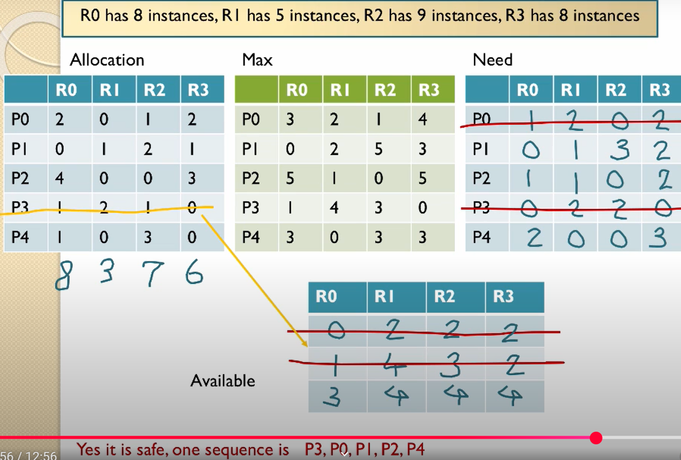
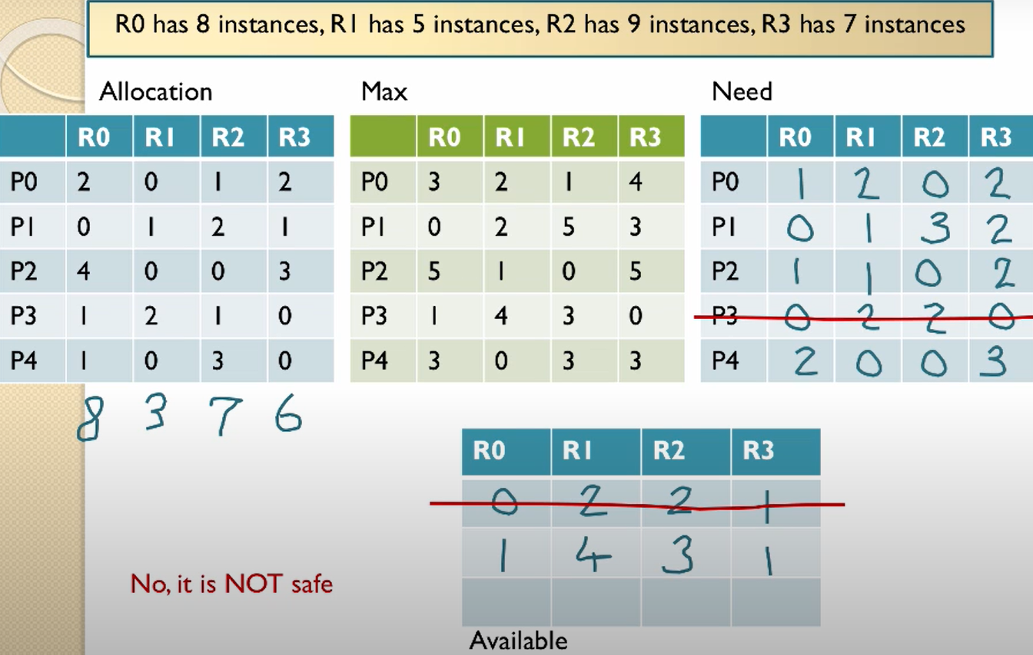
Video tutorial of Banker's algorithm I
Deadlock avoidance https://www.youtube.com/watch?v=AvPjOyeJbBM
Total resources: [8, 5, 9, 8]

Slide 13
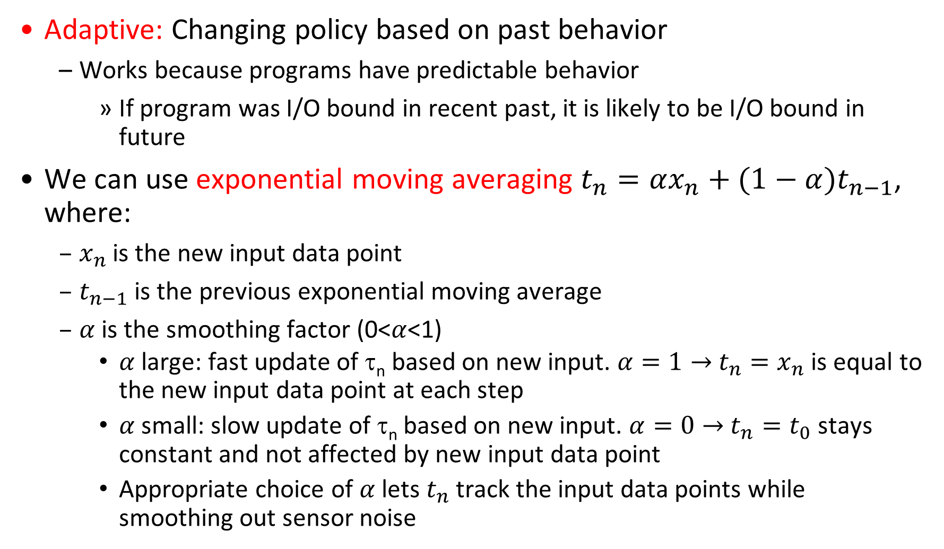
Predicting Length of the Next CPU Burst
Adaptive: Changing policy based on past behavior
Works because programs have predictable behavior
If program was I/O bound in recent past, it is likely to be I/O bound in future
We can use exponential moving averaging ${t_{n}=αx_{n}+(1−α)t}_{n−1}$, where:
$x_{n}$ is the new input data point
$t_{n−1}$ is the previous exponential moving average
$α$ is the smoothing factor (0<$α$<1)
$α$ large: fast update of τ_{n} based on new input. $α=1→$ $t_{n}=x_{n}$ is equal to the new input data point at each step
$α$ small: slow update of τ_{n} based on new input. $α=0→$ $t_{n}=t_{0}$ stays constant and not affected by new input data point
Appropriate choice of $α$ lets $t_{n}$ track the input data points while smoothing out sensor noise
Notes:
CPU scheduling, in virtual memory, in file systems, etc
Let t_{n-1}, t_{n-2}, t_{n-3}, etc. be previous CPU burst lengths. We need to estimate/predict next burst length τ_{n} = f(t_{n-1}, t_{n-2}, t_{n-3}, …) based on previous burst lengths.
Function f may be one of many different time series estimators (Kalman filters, etc)
where t_{n-1}, t_{n-2}, t_{n-3}, etc. are previous CPU burst lengths, and τ_{n} is the predicted next CPU burst length.
t_{i} = actual burst time of process P_{i}, i = n, n-1, n-2, …
τ_{n} = predicted burst time for process P_{n}
α is the smoothing factor (0 <= α <=1)
For instance, exponential averaging τ_{n} = αt_{n-1}+(1-α)τ_{n-1} with (0<α≤1)
α large: fast update of τ_{n} based on
new input.
α small: slow update of τ_{n} based on
new input.

Slide 14
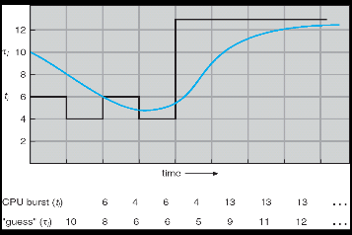
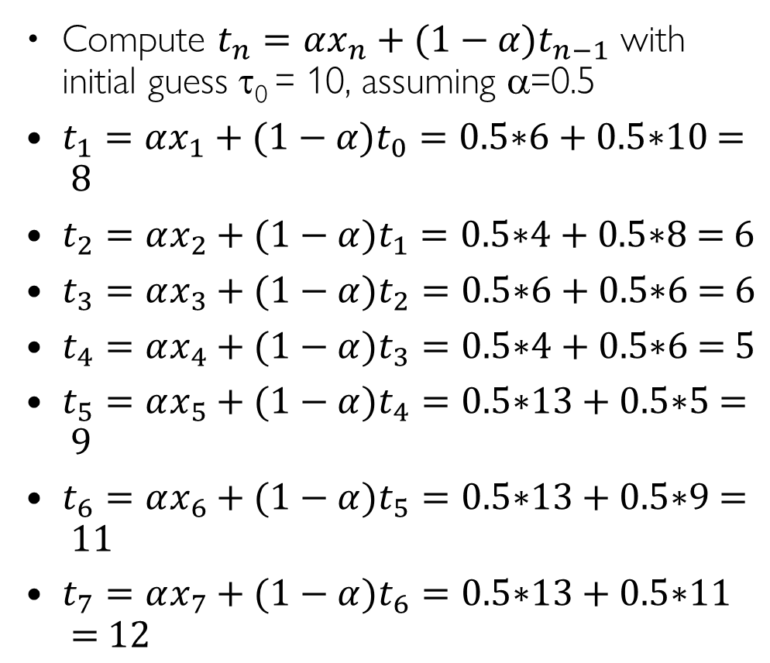
Predicting Length of the Next CPU Burst: α=0.5
Compute ${t_{n}=αx_{n}+(1−α)t}_{n−1}$ with initial guess τ₀ = 10, assuming α=0.5
${t_{1}=αx_{1}+(1−α)t}_{0}=\text{0.5}\text{∗}\text{6 }\text{+ }\text{0.5}\text{∗}\text{10 }\text{= }\text{8}$
${t_{2}=αx_{2}+(1−α)t}_{1}=\text{0.5}\text{∗}\text{4 }\text{+ }\text{0.5}\text{∗}\text{8 }\text{= }\text{6}$
${t_{3}=αx_{3}+(1−α)t}_{2}=\text{0.5}\text{∗}\text{6 }\text{+ }\text{0.5}\text{∗}\text{6 }\text{= }\text{6}$
${t_{4}=αx_{4}+(1−α)t}_{3}=\text{0.5}\text{∗}\text{4 }\text{+ }\text{0.5}\text{∗}\text{6 }\text{= }\text{5}$
${t_{5}=αx_{5}+(1−α)t}_{4}=\text{0.5}\text{∗}\text{13 }\text{+ }\text{0.5}\text{∗}\text{5 }\text{= }\text{9}$
${t_{6}=αx_{6}+(1−α)t}_{5}=\text{0.5}\text{∗}\text{13 }\text{+ }\text{0.5}\text{∗}\text{9 }\text{= }\text{11}$
${t_{7}=αx_{7}+(1−α)t}_{6}=\text{0.5}\text{∗}\text{13 }\text{+ }\text{0.5}\text{∗}\text{11 }\text{= }\text{12}$
Time Series 101: Exponential Moving Average, A Visual Guide
https://www.youtube.com/watch?v=joHKNtPYtLo
Notes:
τ₁ = αt₀+(1-α)τ₀= 0.5*6 + 0.5*10 = 8
τ₂ = αt₁+(1-α)τ₁= 0.5*4 + 0.5*8 = 6
τ₃ = αt₂+(1-α)τ₂= 0.5*6 + 0.5*6 = 6
τ₄ = αt₃+(1-α)τ₃= 0.5*4 + 0.5*6 = 5
τ₅ = αt₄+(1-α)τ₄= 0.5*13 + 0.5*5 = 9
τ₆ = αt₅+(1-α)τ₅= 0.5*13 + 0.5*9 = 11
τ₇ = αt₆+(1-α)τ₆= 0.5*13 + 0.5*11 = 12

Slide 15
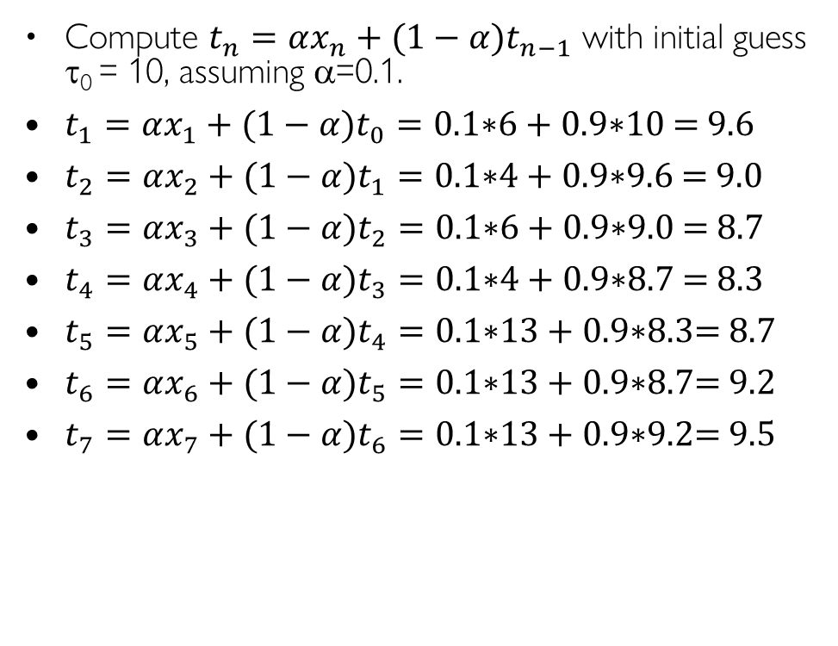
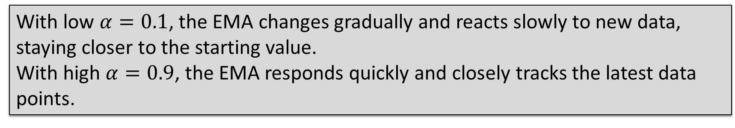
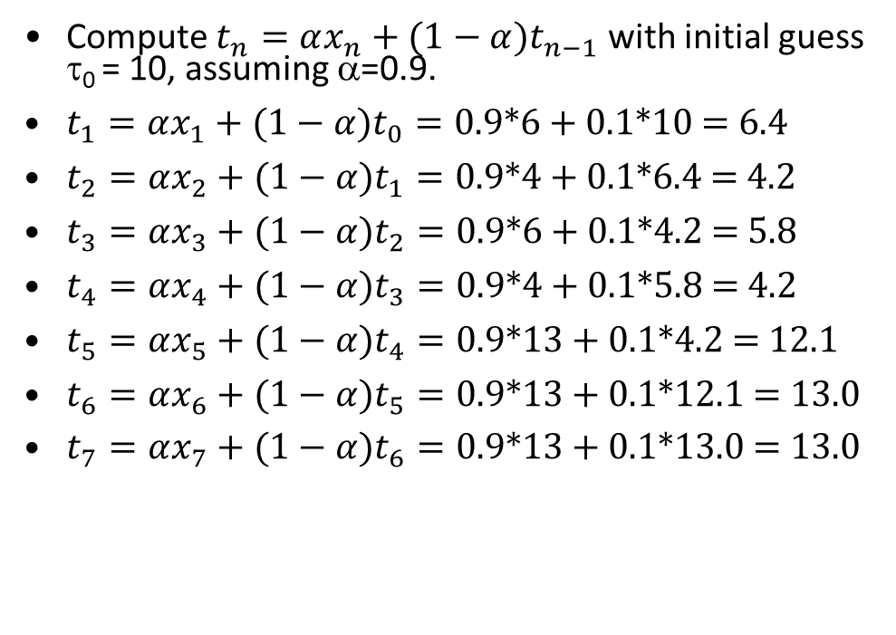
Predicting the Length of the Next CPU Burst: α=0.1 or 0.9
Compute ${t_{n}=αx_{n}+(1−α)t}_{n−1}$ with initial guess τ₀ = 10, assuming α=0.1.
${t_{1}=αx_{1}+(1−α)t}_{0}=\text{0.}\text{1}\text{∗}\text{6 }\text{+ }\text{0.9}\text{∗}\text{10 }\text{= }\text{9.6}$
${t_{2}=αx_{2}+(1−α)t}_{1}=\text{0.}\text{1}\text{∗}\text{4 }\text{+ }\text{0.9}\text{∗}\text{9.6} \text{= }\text{9.0}$
${t_{3}=αx_{3}+(1−α)t}_{2}=\text{0.}\text{1}\text{∗}\text{6 }\text{+ }\text{0.9}\text{∗}\text{9.0 }\text{= }\text{8.7}$
${t_{4}=αx_{4}+(1−α)t}_{3}=\text{0}\text{.}\text{1}\text{∗}\text{4 }\text{+ }\text{0.9}\text{∗}\text{8.7} \text{= }\text{8.3}$
${t_{5}=αx_{5}+(1−α)t}_{4}=\text{0.}\text{1}\text{∗}\text{13 }\text{+ }\text{0.9}\text{∗}\text{8.3}\text{= }\text{8.7}$
${t_{6}=αx_{6}+(1−α)t}_{5}=\text{0.}\text{1}\text{∗}\text{13 }\text{+ }\text{0.9}\text{∗}\text{8.7}\text{= }\text{9.2}$
${t_{7}=αx_{7}+(1−α)t}_{6}=\text{0.}\text{1}\text{∗}\text{13 }\text{+ }\text{0.9}\text{∗}\text{9.2}\text{= }\text{9.5}$
Compute ${t_{n}=αx_{n}+(1−α)t}_{n−1}$ with initial guess τ₀ = 10, assuming α=0.9.
${t_{1}=αx_{1}+(1−α)t}_{0}=\text{0.}\text{9}\text{∗}\text{6 }\text{+ }\text{0.1}\text{∗}\text{10 }\text{=} \text{6.4}$
${t_{2}=αx_{2}+(1−α)t}_{1}=\text{0.}\text{9}\text{∗}\text{4 }\text{+ }\text{0.1}\text{∗}\text{6.4} \text{= }\text{4.2}$
${t_{3}=αx_{3}+(1−α)t}_{2}=\text{0.}\text{9}\text{∗}\text{6 }\text{+ }\text{0.1}\text{∗}\text{4.2 }\text{= }\text{5.8}$
${t_{4}=αx_{4}+(1−α)t}_{3}=\text{0.}\text{9}\text{∗}\text{4 }\text{+ }\text{0.1}\text{∗}\text{5.8 }\text{= }\text{4.2}$
${t_{5}=αx_{5}+(1−α)t}_{4}=\text{0.}\text{9}\text{∗}\text{13 }\text{+ }\text{0.1}\text{∗}\text{4.2} \text{= }\text{12.1}$
${t_{6}=αx_{6}+(1−α)t}_{5}=\text{0.}\text{9}\text{∗}\text{13 }\text{+ }\text{0.1}\text{∗}\text{12.1} \text{= }\text{13.0}$
${t_{7}=αx_{7}+(1−α)t}_{6}=\text{0.}\text{9}\text{∗}\text{13 }\text{+ }\text{0.1}\text{∗}\text{13.0} \text{= }\text{13.0}$
With low $α=0.1$, the EMA changes gradually and reacts slowly to new data, staying closer to the starting value.
With high $α=0.9$, the EMA responds quickly and closely tracks the latest data points.
Notes:
τ₁ = αt₀+(1-α)τ₀= 0.5*6 + 0.5*10 = 8
τ₂ = αt₁+(1-α)τ₁= 0.5*4 + 0.5*8 = 6
τ₃ = αt₂+(1-α)τ₂= 0.5*6 + 0.5*6 = 6
τ₄ = αt₃+(1-α)τ₃= 0.5*4 + 0.5*6 = 5
τ₅ = αt₄+(1-α)τ₄= 0.5*13 + 0.5*5 = 9
τ₆ = αt₅+(1-α)τ₅= 0.5*13 + 0.5*9 = 11
τ₇ = αt₆+(1-α)τ₆= 0.5*13 + 0.5*11 = 12

Slide 16
Lecture 5 Scheduling Conclusion
FCFS Scheduling:
Run jobs in the order of arrival
Cons: Short jobs can get stuck behind long ones
Round-Robin Scheduling:
Give each thread a small amount of CPU time when it executes; cycle between all ready threads
Pros: Better for short jobs
Shortest Job First (SJF)/Shortest Remaining Time First (SRTF):
Run whatever job has the least execution time/least remaining execution time
Pros: Optimal (in terms of average response time)
Cons: Hard to predict execution time, Unfair
Priority-Based Scheduling
Each job is assigned a fixed priority
Multi-Level Queue Scheduling
Multiple queues of different priorities and scheduling algorithms
Multi-Level Feedback Queue Scheduling:
Automatic promotion/demotion of jobs between queues to approximate SJF/SRTF
Notes:
Many textbooks use the “old model”—one thread per job
Usually it's really: threads (e.g., in Linux)
One point to notice: switching threads vs. switching jobs incurs different costs:
Switch threads: Save/restore registers
Switch jobs: Change active address space too!
Expensive
Disrupts caching
Scheduling: selecting a waiting process from the ready queue and allocating the CPU to it
FCFS Scheduling:
Pros: Simple
Cons: Short jobs can get stuck behind long ones
Round-Robin Scheduling:
Pros: Better for short jobs
Cons: Poor performance when jobs have same length
Pros: Simple
Shortest Job First (SJF) and Shortest Remaining Time First (SRTF)
Run the job with least amount of computation to do/least remaining amount of computation to do
Pros: Optimal (average response time)
Cons: Hard to predict future, Unfair
Priority-Based Scheduling
Each process is assigned a fixed priority
Multi-Level Queue Scheduling
Multiple queues of different priorities
Multi-Level Feedback Queue Scheduling:
Automatic promotion/demotion of process between queues
Lottery Scheduling:
Give each process a number of tickets (short tasks ⇒ more tickets)
Reserve a minimum number of tickets for every process to ensure forward progress
See animations of common scheduling algorithms

Slide 17
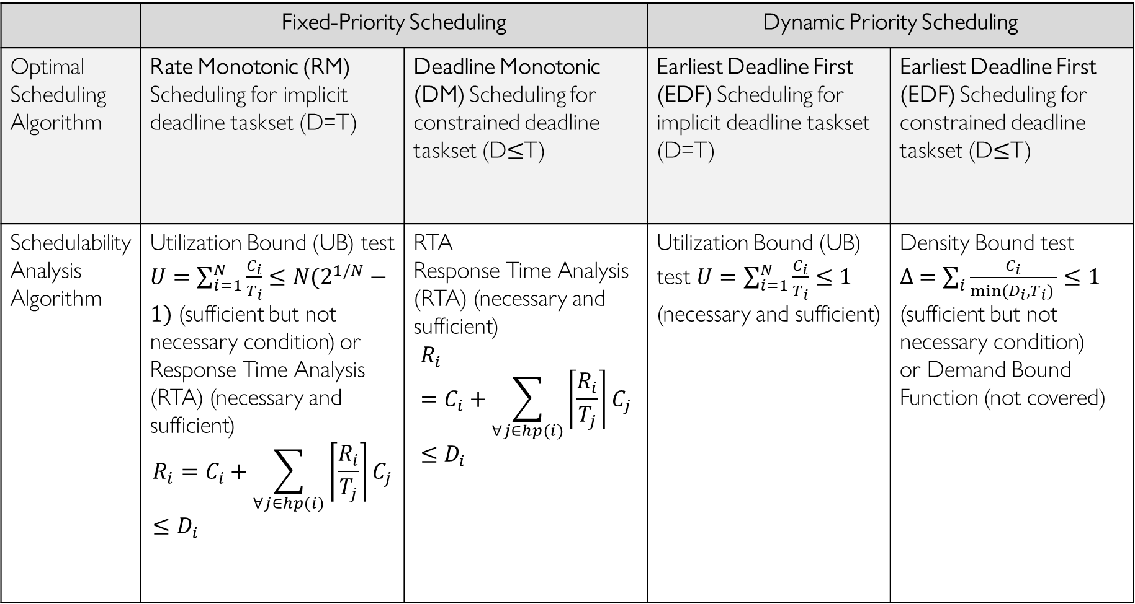
Summary of Schedulability Analysis Algorithms
IMPORTANT
 | Fixed-Priority Scheduling |  | Dynamic Priority Scheduling
Optimal Scheduling Algorithm | Rate Monotonic (RM) Scheduling for implicit deadline taskset (D=T) | Deadline Monotonic (DM) Scheduling for constrained deadline taskset (D$≤$T) | Earliest Deadline First (EDF) Scheduling for implicit deadline taskset (D=T) | Earliest Deadline First (EDF) Scheduling for constrained deadline taskset (D$≤$T)
Schedulability Analysis Algorithm | Utilization Bound (UB) test $U=\sum_{i=1}^{N}{\frac{C_{i}}{T_{i}}}≤N(2^{1/N}−1)$ (sufficient but not necessary condition) or Response Time Analysis (RTA) (necessary and sufficient) $$R_{i}=C_{i}+\sum_{∀j∈hp(i)}{\left\lceil \frac{R_{i}}{T_{j}}\right\rceil C_{j}}≤D_{i}$$ | RTA Response Time Analysis (RTA) (necessary and sufficient) $$R_{i}=C_{i}+\sum_{∀j∈hp(i)}{\left\lceil \frac{R_{i}}{T_{j}}\right\rceil C_{j}}≤D_{i}$$ | Utilization Bound (UB) test $U=\sum_{i=1}^{N}{\frac{C_{i}}{T_{i}}}≤1$ (necessary and sufficient) | Density Bound test $∆ =\sum_{i}{\frac{C_{i}}{min(D_{i},T_{i}) }}≤1$ (sufficient but not necessary condition) or Demand Bound Function (not covered)

Slide 18
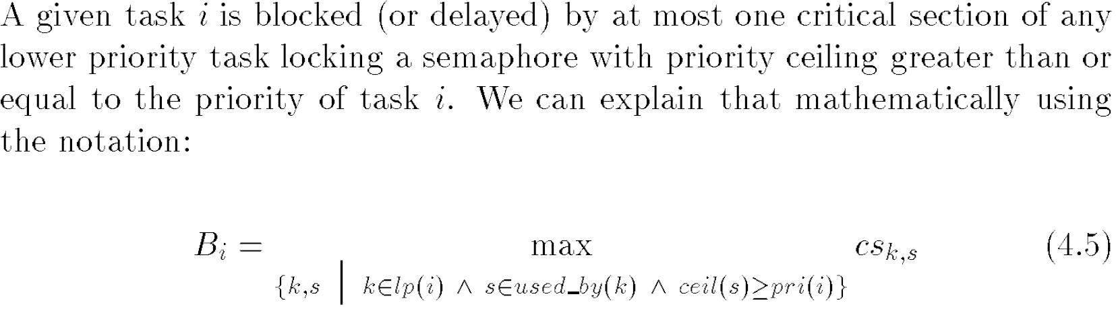
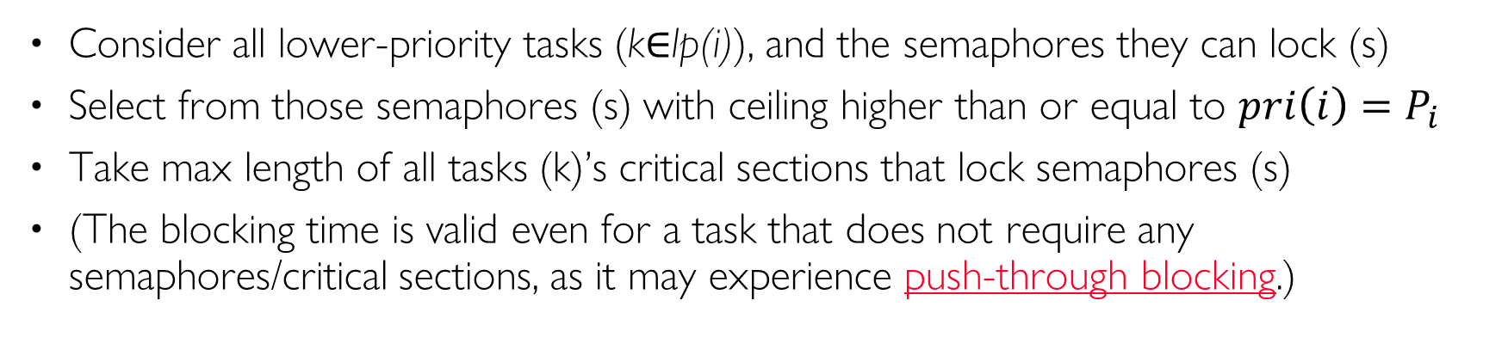
PCP Blocking Time
Consider all lower-priority tasks (k$∈$lp(i)), and the semaphores they can lock (s)
Select from those semaphores (s) with ceiling higher than or equal to ${pri\left(i\right)=P}_{i}$
Take max length of all tasks (k)’s critical sections that lock semaphores (s)
(The blocking time is valid even for a task that does not require any semaphores/critical sections, as it may experience push-through blocking.)
Notes:
. Blocking delay is MAX length of critical sections of all lower-priority tasks (vs. SUM for PIP)

